Slide 1

Webservices and Database Team Profile Generator

Slide 2
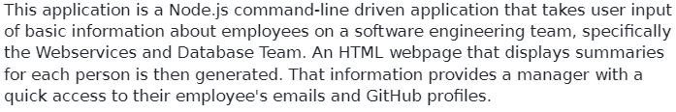
Application

Slide 3
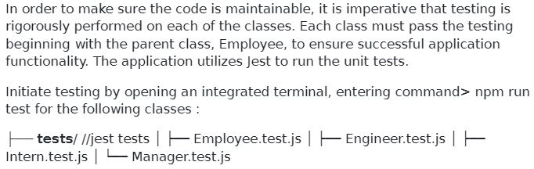
Initiate Unit Testing

Slide 4

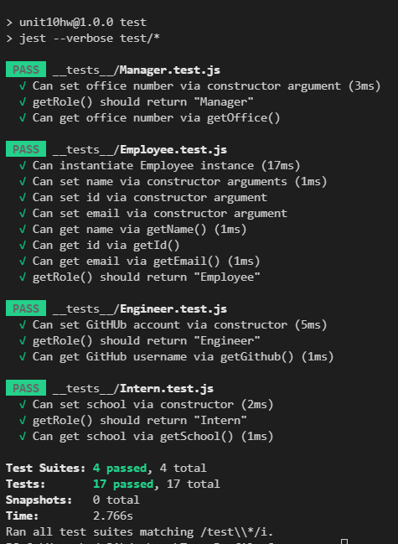
Initialize Testing

Slide 5
Invoke Application!

Slide 6
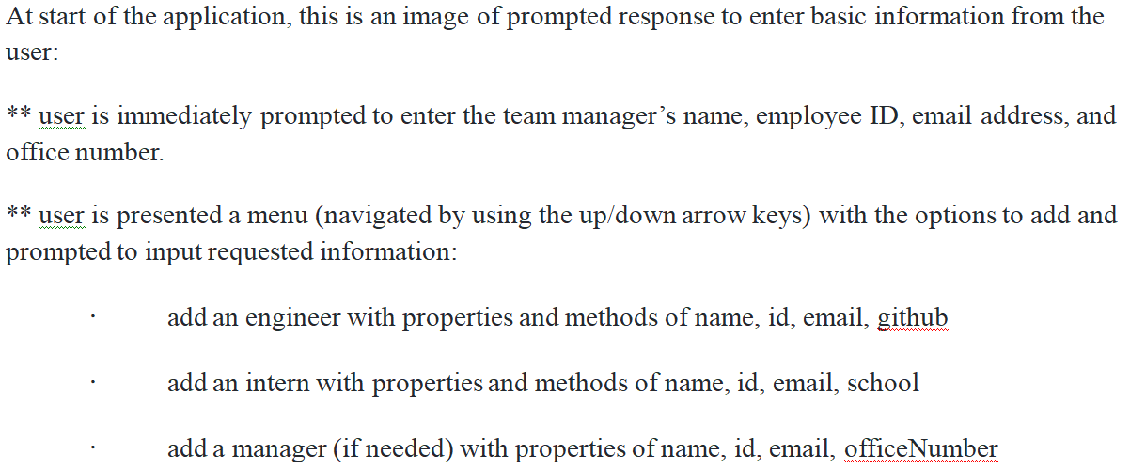
User Input (Prompted)

Slide 7
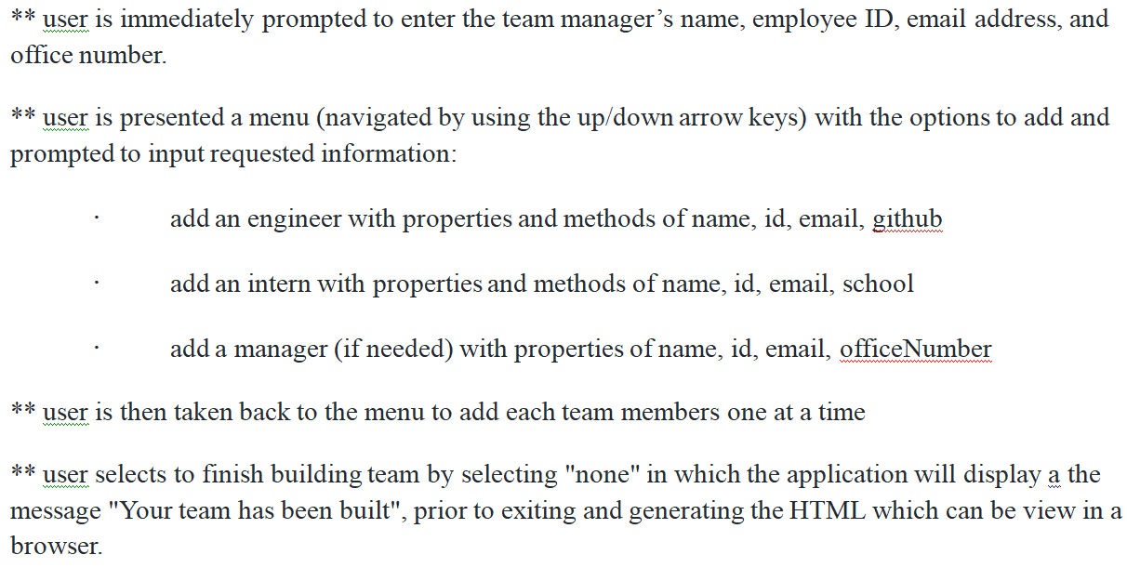
User Input (Prompted) - continued

Slide 8
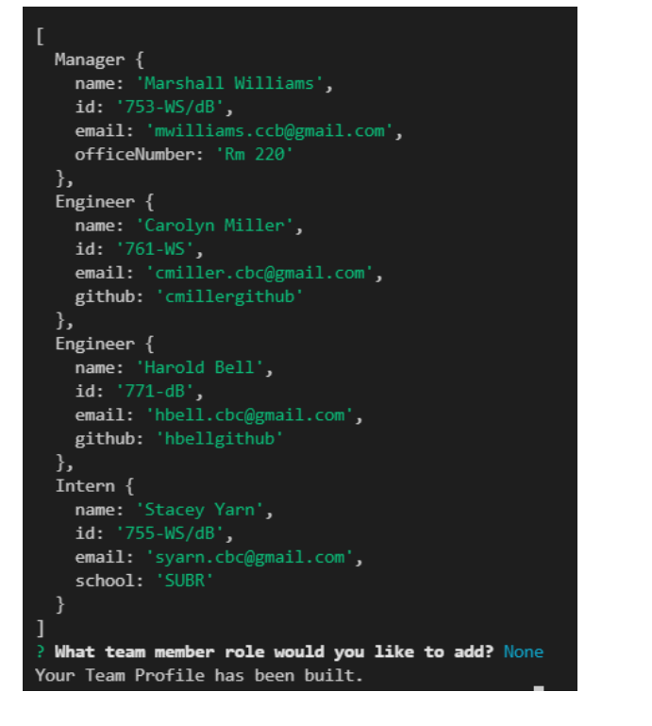
User Input (Entries)

Slide 9
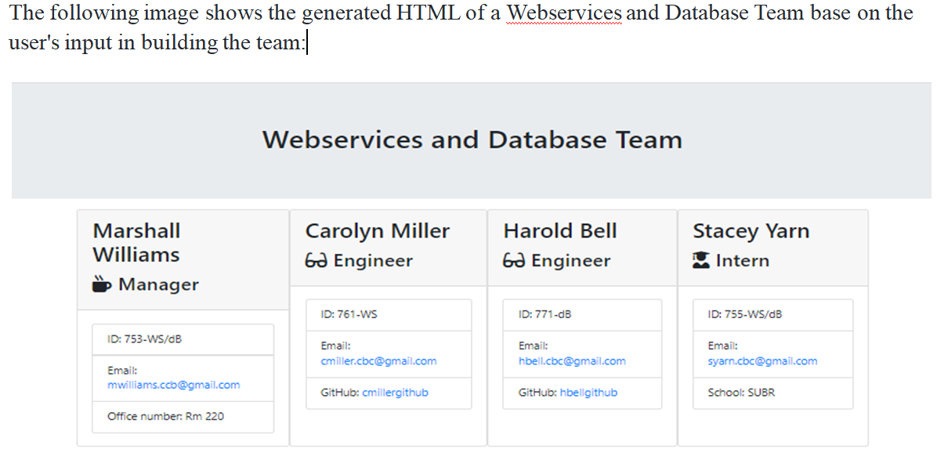
Generated HTML

Slide 10
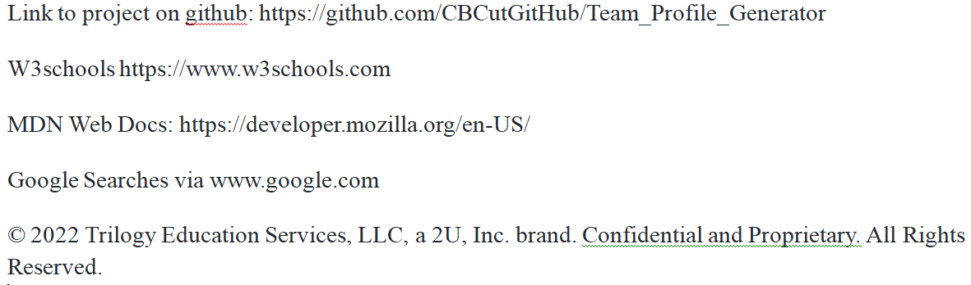
Links, References and Resources

